Slide 1
Food
RX

Slide 2
Let Food Be Thy Medicine and Medicine Be Thy Food
~ Hippocrates

Slide 3
1
Systems for Food Rx
2
Food Rx at a Healthcare Institution
(Riverwood Healthcare Center)
& Participant Feedback
3
Food Rx with the Local Food System
Aitkin Farmers Market Hub
Table of Content
4
Lessons Learned & Future Ideas

Slide 4
Introduction
Riverwood Healthcare Center was a recipient from the Minnesota Department of Health for a GusNIP grant for 3 years.
The Hub receives support from Renewing the Countryside; Minnesota Farmers Market Association, Minnesota Institute of Sustainable Agriculture and the Statewide Health Improvement Partnership (SHIP) program.

Slide 5
The Local Aitkin County Food System keeps our Communities Thriving!

Slide 6
Food Rx - Systems
Riverwood Healthcare Center
Those who qualify for the Food Rx program can receive a weekly Community Supported Agriculture (CSA) share of fruits and vegetables grown by local farmers.
Aitkin Farmers Market
Aitkin Farmers
Market Hub
The Aitkin Farmers’ Market offers a variety of fresh seasonal fruits and vegetables, plus much more! Soaps, woodcrafts, honey, freshly baked items, preserves, pottery, jewelry, sauces and more can be found there – all grown or made by local growers and makers.
Food hubs bring together produce from multiple farmers and offer it to larger-scale buyers.

Slide 7
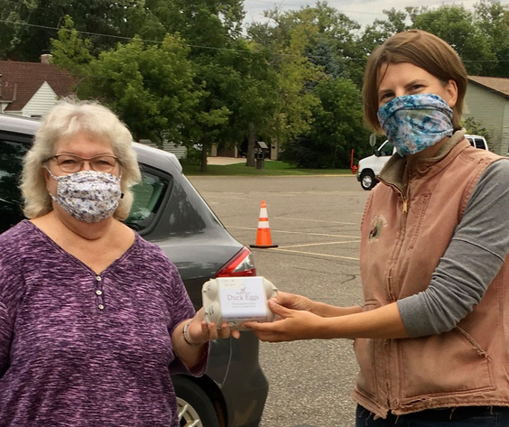
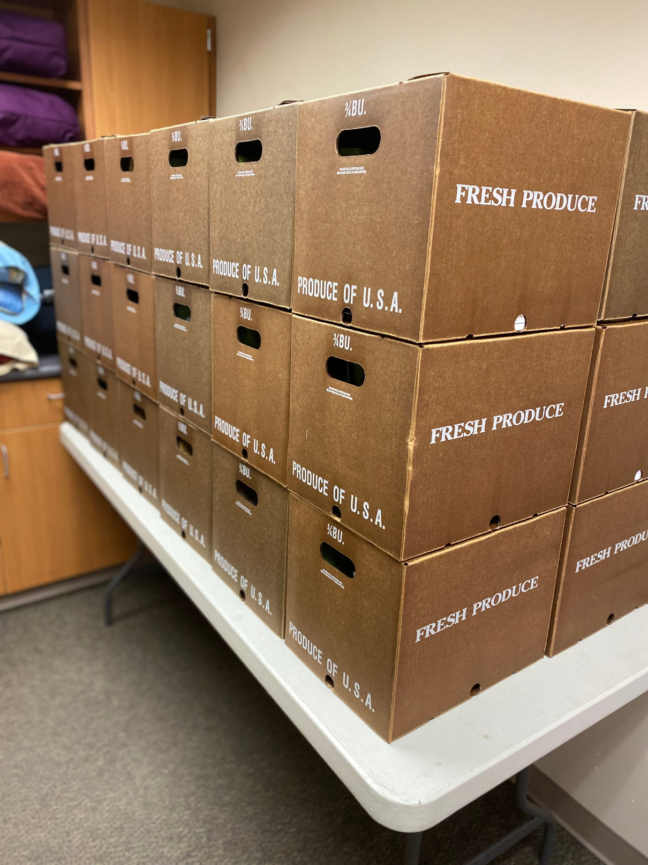
Aitkin Farmers
Market Hub
Farmers who don't have enough time or product to reach larger markets on their own can sell through a food hub. Buyers who can't deal with seperate accounts for multiple farmers can buy local through a food hub.
How It’s Going!
2019
How it Started!
2023 - 2024
Farm to School
Aitkin
Hill City
Restaurants
Food Rx
Aitkin Farm Fresh
Veggie Sides Box
Market Share Box
Farm to School Contracts
CSA Shares Drive Thru Pick Up model for the Community

Slide 8
Aitkin Farmers Market
The farmers market has built up their system at the market in order to be able to offer “scrips” at the market (i.e. SNAP, Market Bucks, PoP coupons, Riverwood Connects Market Bucks and WIC checks!

Slide 9
Riverwood Healthcare Center
A new program that Riverwood launched this summer is Food Rx. This program provides patients and their families access to fresh fruit and vegetables through a collaborative effort with the Minnesota Department of Health, Aitkin County SHIP and Aitkin Farmers Hub.

Slide 10
Grocery Store
Riverwood partners with the local grocery store to fill in the gap when the local food system is tapped out and can no longer provide.

Slide 11
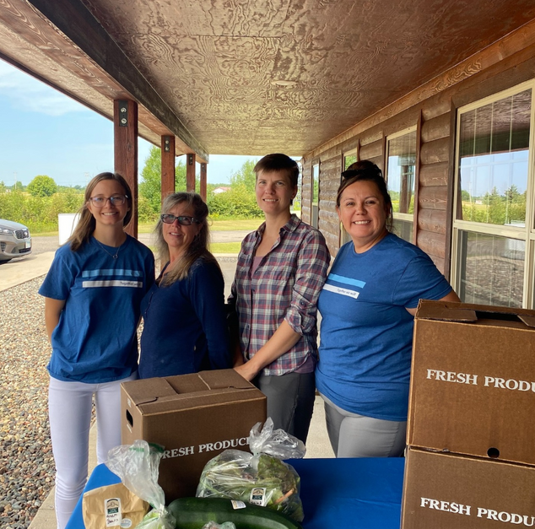
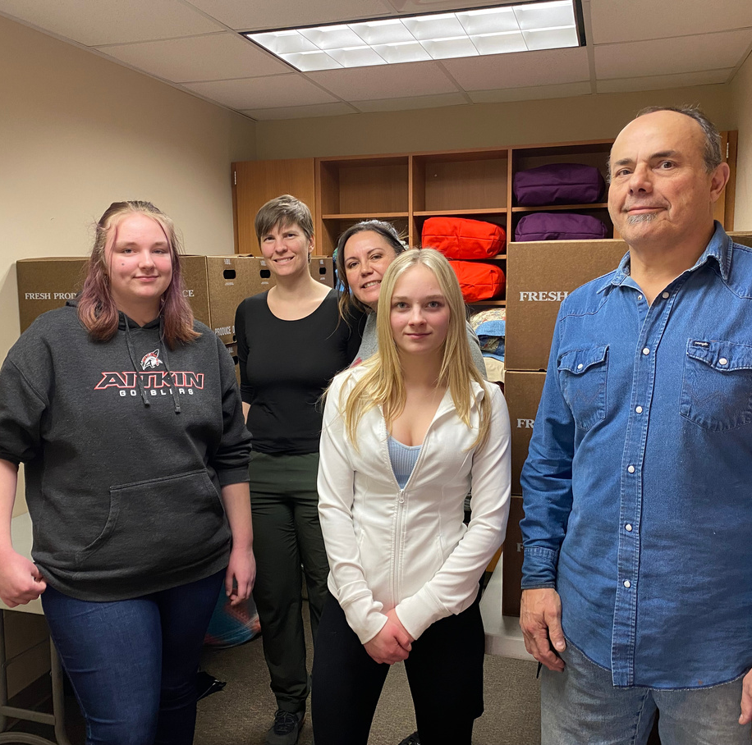
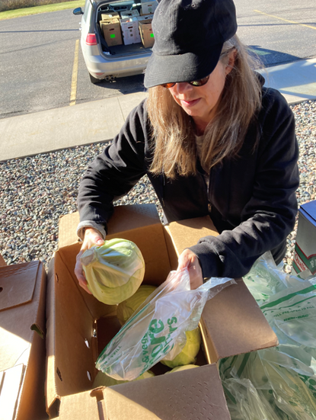
Volunteers
Riverwood Auxiliary
Aitkin Lions Club
Aitkin County CARE volunteers
Aitkin School District FFA

Slide 14
The Hunger Vital Sign

Slide 15
Population to screen for eligibility
medicare wellness check appointment
IBT patients
Opioid Text patients
Is the person all three of these?
Over 18
Eligible for SNAP benefits, enrolled in SNAP or enrolled in medical assistance
A member of a low - income household that suffers from, or is at risk of developing, a diet - related health condition (using the 2 question Hunger Vital Screening)
No
(Not eligible for GusNIP Food Rx)
Yes
(They are eligible for GusNIP Food Rx)

Slide 16
Outpatient Coordinator will contact them to:
Explain the program
Completed the informed consent
Schedule “Pre-Survey“ appointment with RD
Prior to appointment, outpatient coordinator completes informed consent form with patient (10 minutes prior)
Pre - Survey Appointment (15 minutes with RD)
Complete pre-survey (or they could complete the survey on paper 10 minutes fore the visit if there is someone who enters it later)
Give the patient the folder with nutrition education
1 piece of nutrition education
Explain next steps and provide $10 for completing pre - survey
See Registered Dietitian

Slide 17
Flow for Food Rx Market Box - For the Participant
Patient receives at least 4 Food Rx Market Boxes + ($1 x 50) “Bucks” over the course of the program
Optional: Patient receives optional nutrition education (virtually or in person)
Outpatient Coordinator schedules post - survey RD visit
Flow for RD “Post - Survey” Appointment
Post - Survey Appointment: 15 minutes RD Appointment
Provide any updates on study procedures to continue informed consent (if there are any changes to the study protocol - i.e. extra boxes)
Complete post - survey (or they could complete survey on paper 10 minutes before the visit if there is someone who enters it later).
Other (ask for feedback, explain next steps, share information about reenrollment next season)
1 piece of nutrition education

Slide 18
Program | Program Details | Program Reach
Food Rx GusNIP Grant | Community Supported Agriculture (CSA) Share vegetable boxes distributed monthly aggregated from Hub and offset with produce from local grocer Offers home delivery or pick - up at clinic locations Aitkin Farmers Market Hub - works with 9 farmers throughout the county, Aitkin County SHIP | 111 Referred 74 Participants Enrolled 9 Dropped Out 1 On Hold Until Summer
 | Patients and community members can now go to the website and self screen for the Food Rx program All referrals go to Natalie Braden, Outpatient Services Coordinator | 50 Self-Screened 22 No Show 5 Scheduled for March Appointments with RD
Riverwood Connects Bucks | Food Rx participants receive $50 during the summer growing season to spend at the Aitkin Farmers Market or they can redeem to be used for another CSA Share | 54 Participants Received $2,650 Provided $1,037 Used @ Market $225 Used for Extra Box
Food Rx

Slide 19
Program | Program Details | Program Reach
Aitkin Farm Fresh Program LFPA Grant | Aitkin Farmers Market Hub food boxes to be distributed to seniors within Aitkin County Program will run JAN - MAY 2024 / JAN - MAY 2025 Aitkin County CARE and Angels of McGregor will each receive 30 boxes to distribute to seniors they serve. There are no guidelines associated with this program other than food has to be purchased from the local food system. | January 16, 2024 February 5, 2024
Aitkin Farm Fresh
Program | Program Details | Program Reach
Emergency Pantry Packs | Pilot has started with emergency pantry packs Pantry Packs are located: Aitkin, Garrison, McGregor Clinics Behavioral Health Social Services Nutrition Office Emergency Department Aitkin County Health & Human Services | February 5, 2024

Slide 20
Example of Food Rx Boxes

Slide 21
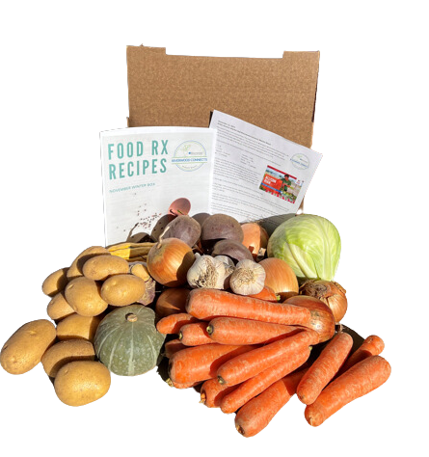
What is inside a Food Rx Box?
5 lbs. Cabbage
2 lbs. Rutabaga
0.75 lb. Garlic
5 lbs. Onions
7 lbs. Potatoes
6 lbs. Squash
4 lbs. Carrots

Slide 22
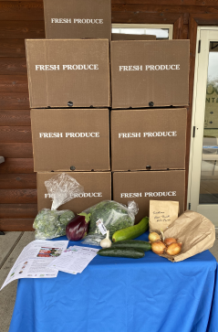
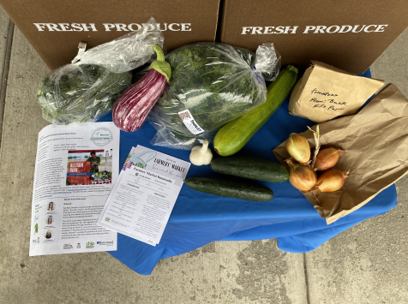
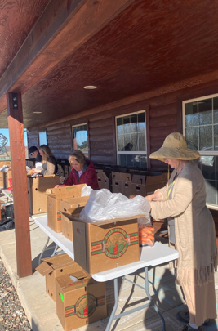
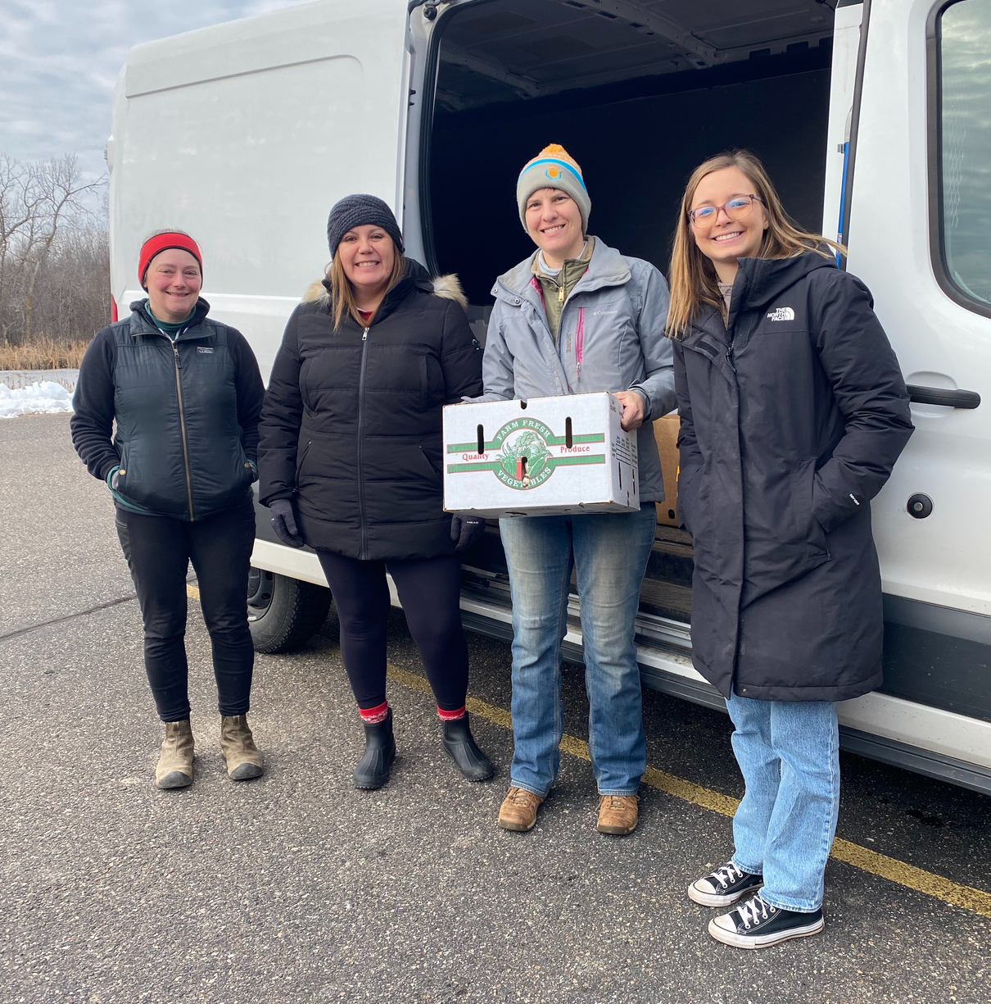
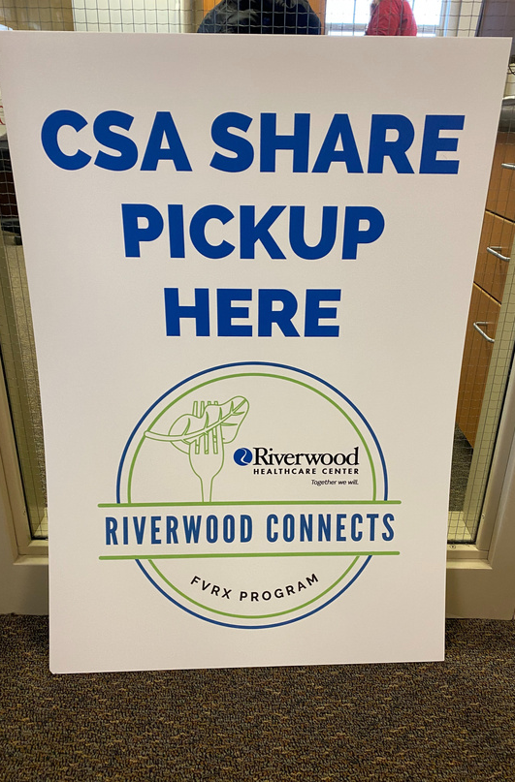
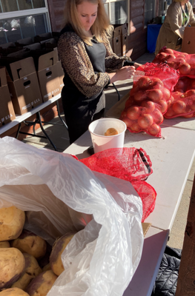
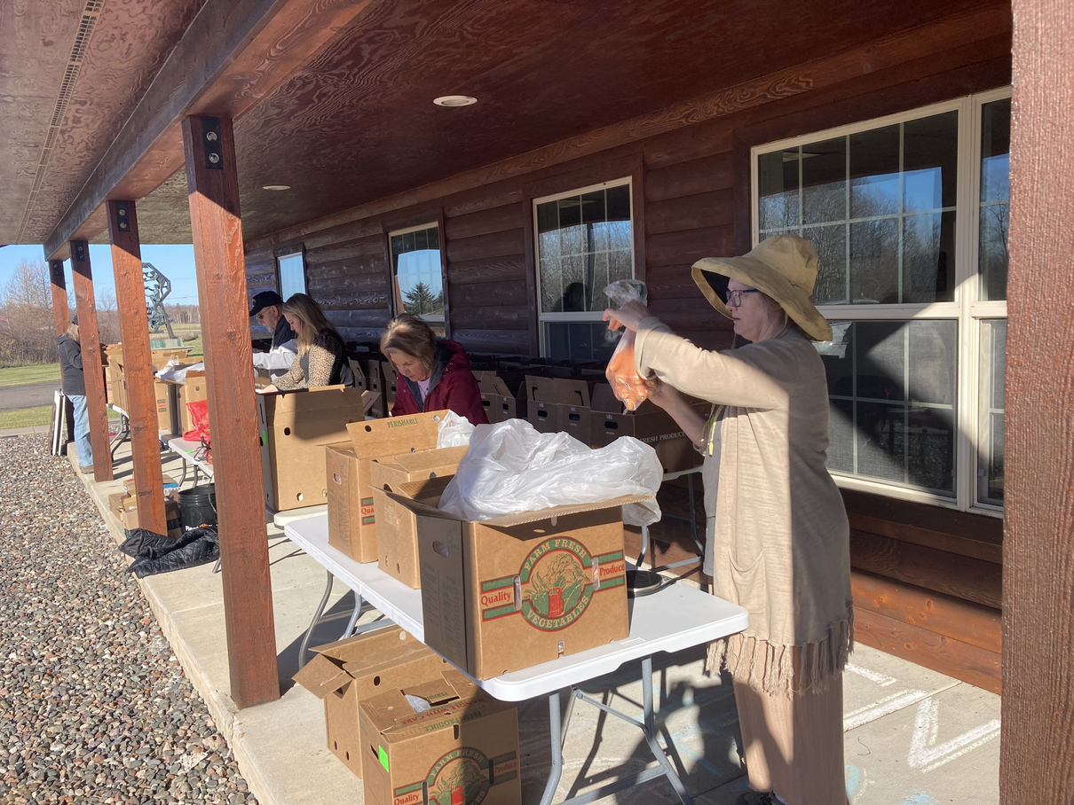
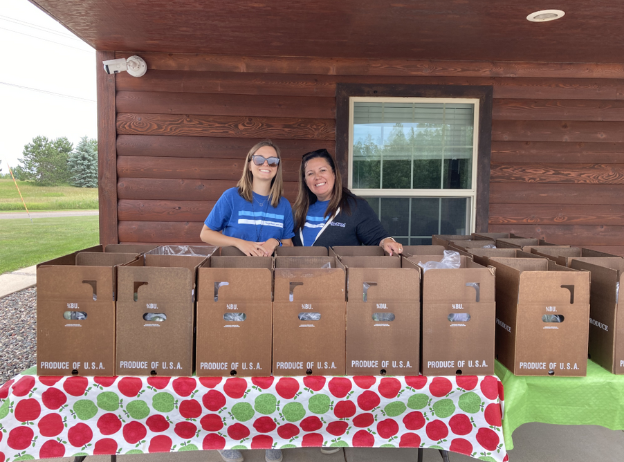
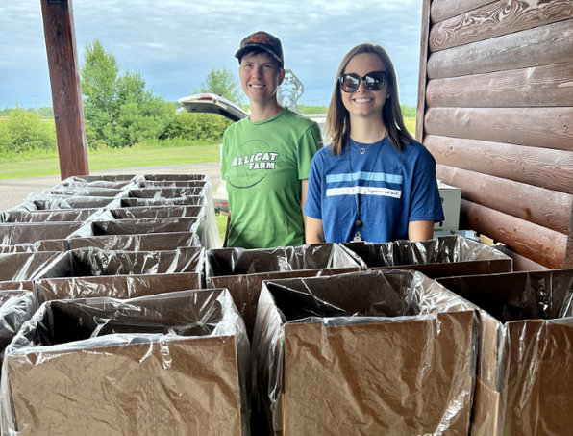

Slide 23
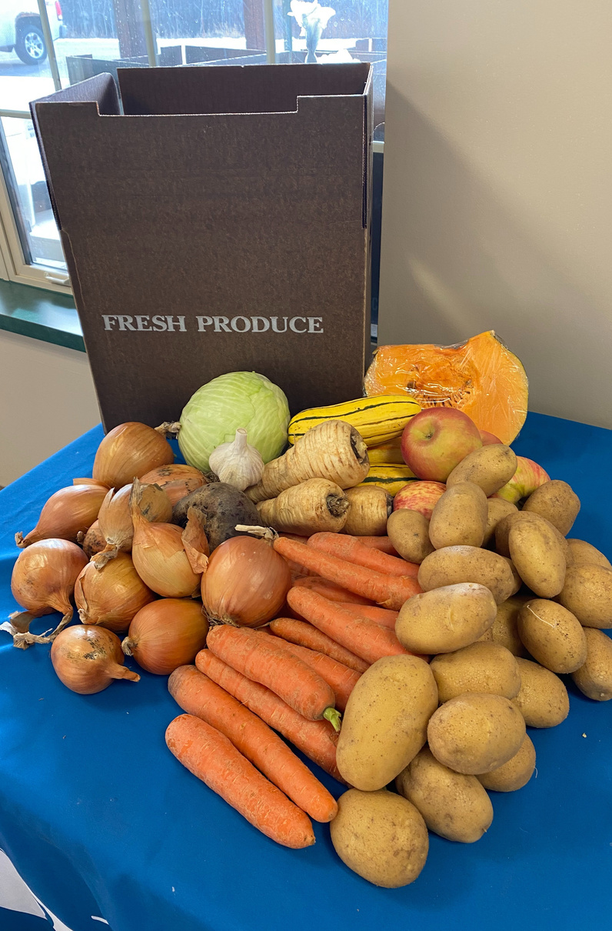
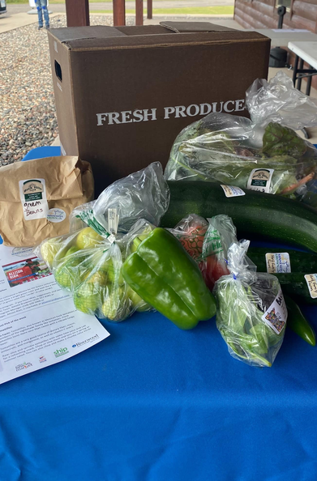
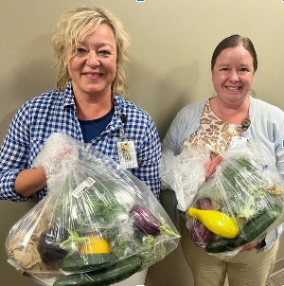
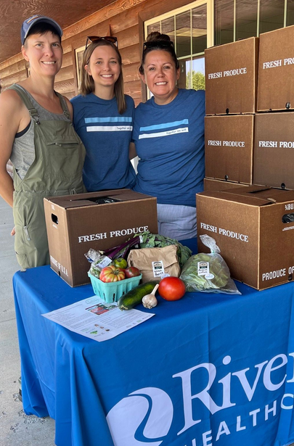
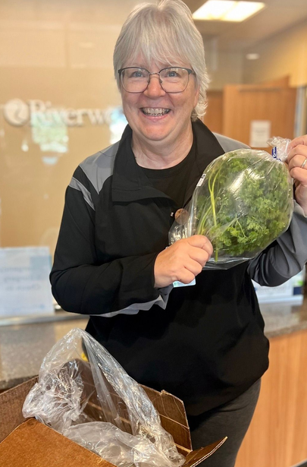
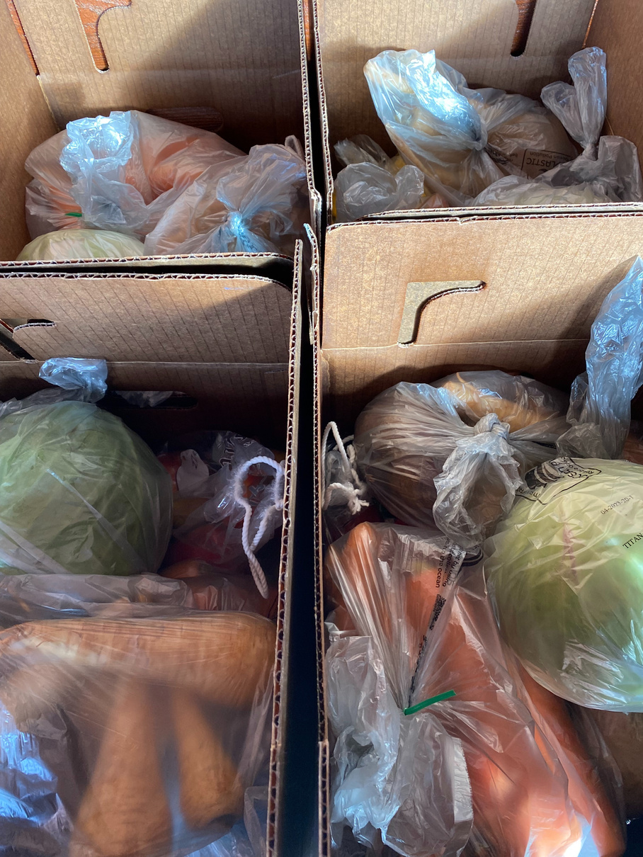
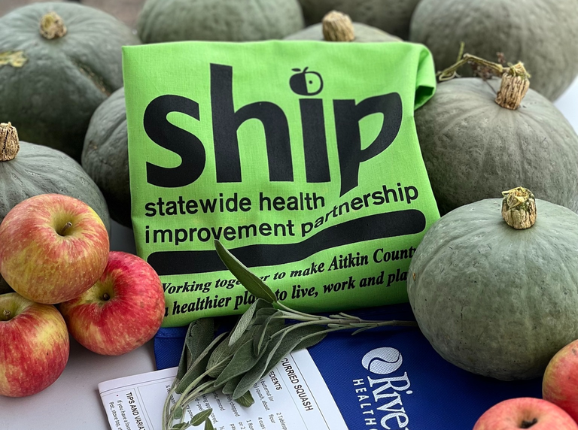
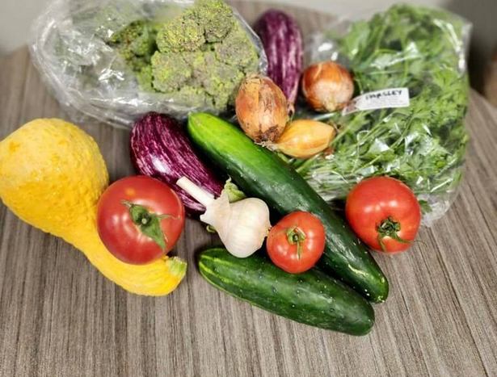

Slide 24
Participant Feedback

Slide 27
Food hubs bring together produce from multiple farmers and offer it to larger-scale buyers.
Notes:
Learn About:
Hub history
Hub income streams
Hub operations & logistics
Benefits of an established hub in the community
Punching above our weight

Slide 28
www.farmersmarkethub.org
Farmers Market Hub Locations
grand rapids
Aitkin
Wabasha
red wing
virginia
Moorhead
willmar
the village community garden in rochester
mankato
killimo farm hub

Slide 30
What does the aggregation process look like ?

Slide 31
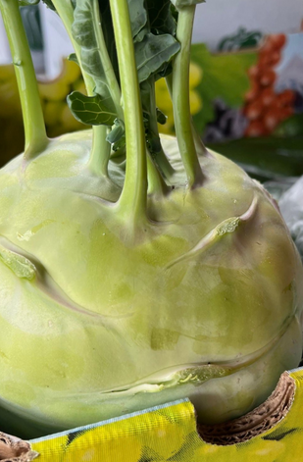
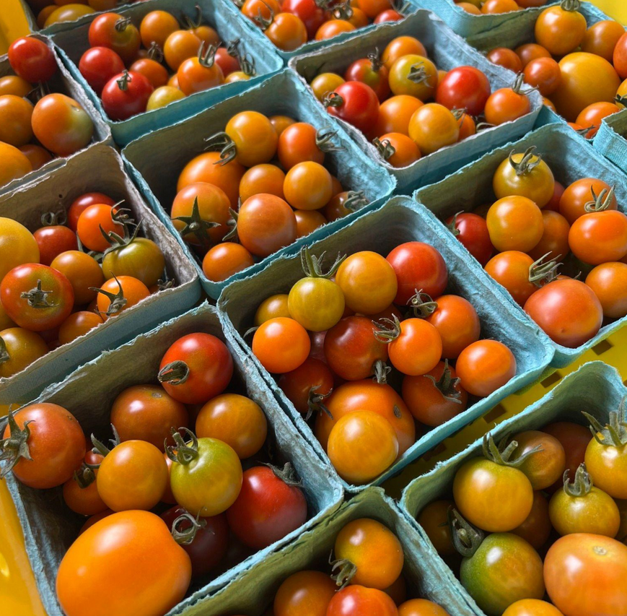
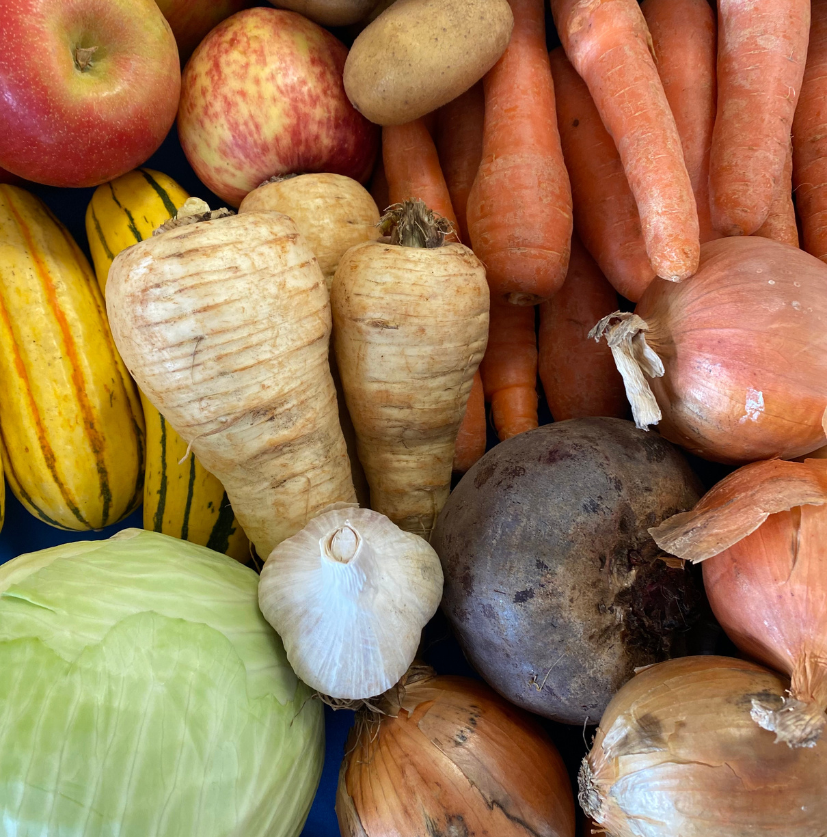
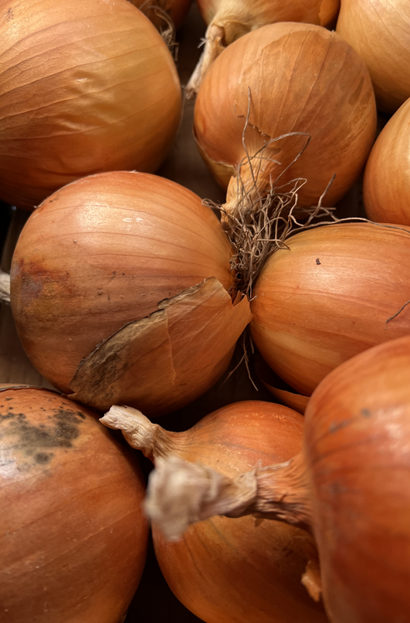
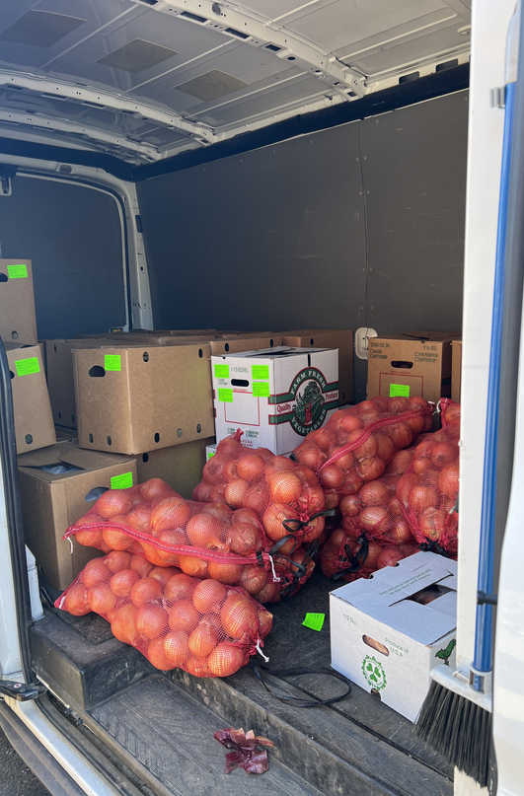
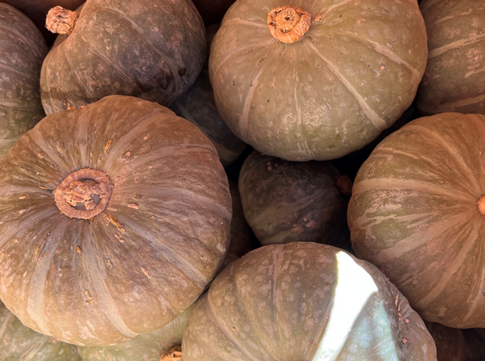
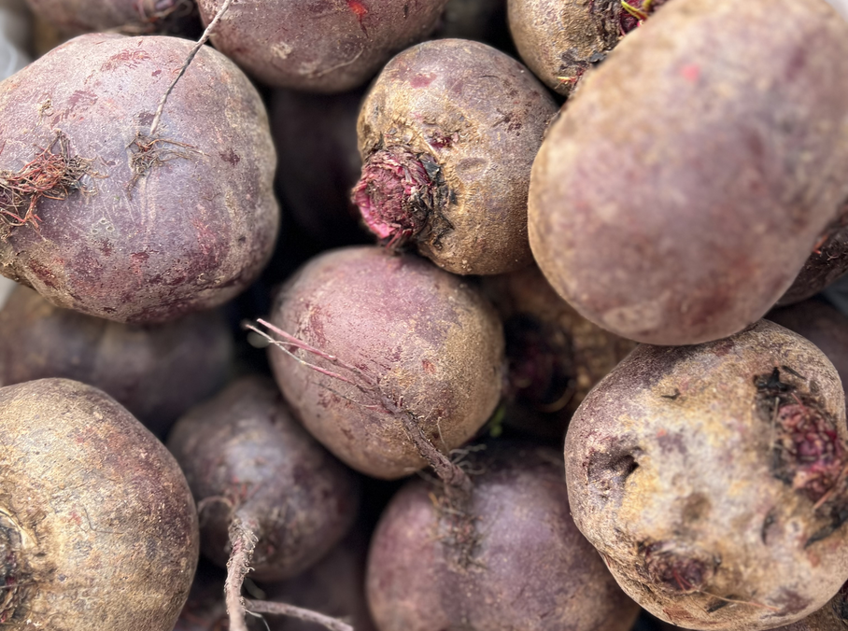
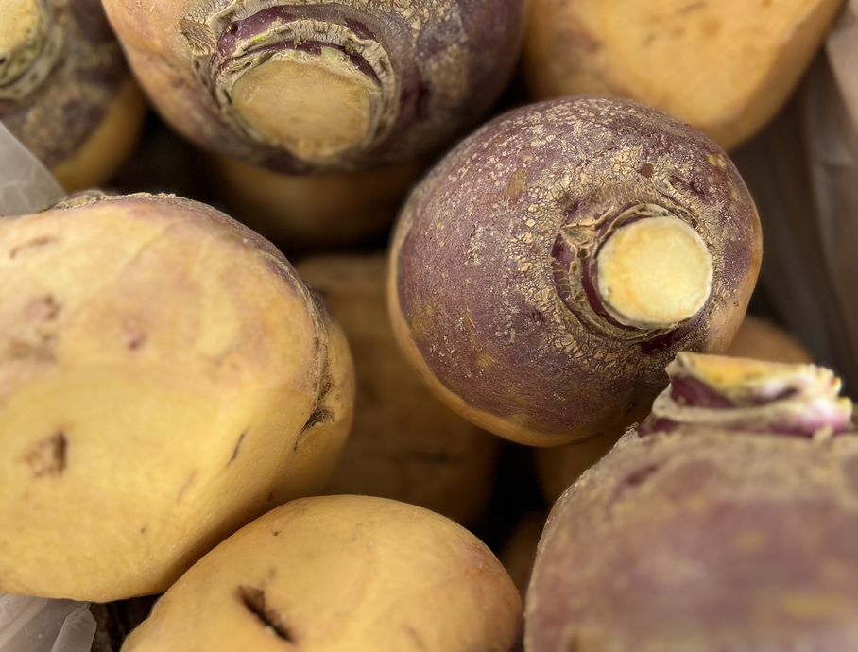

Slide 32
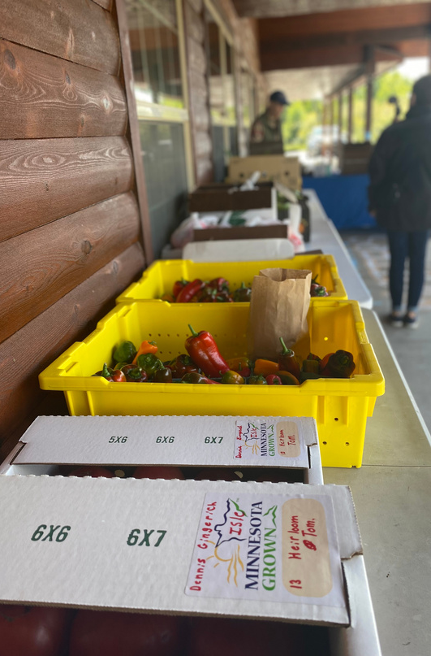
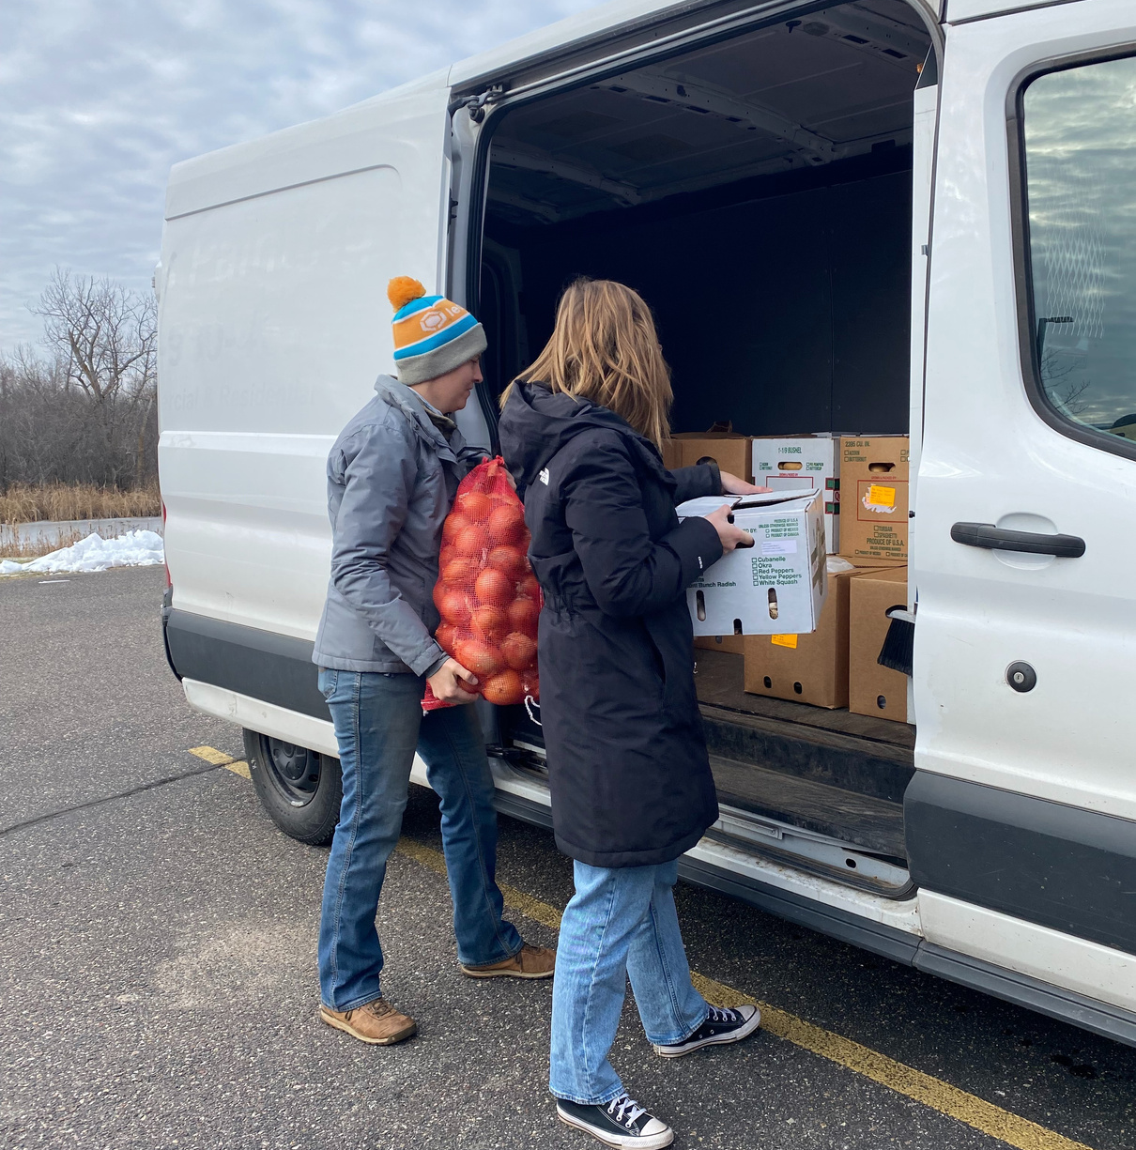
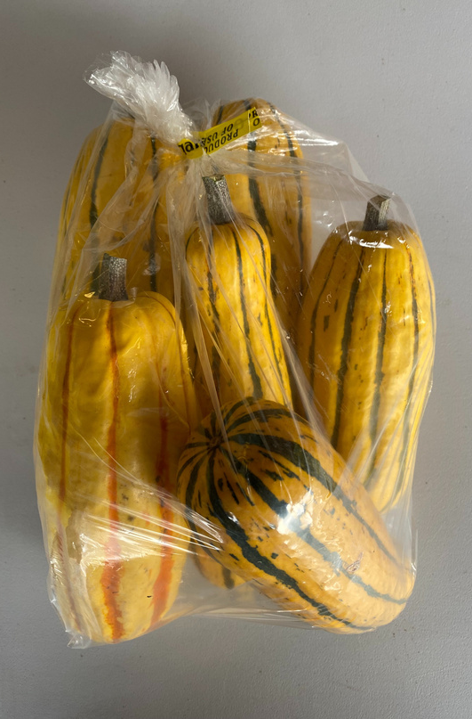
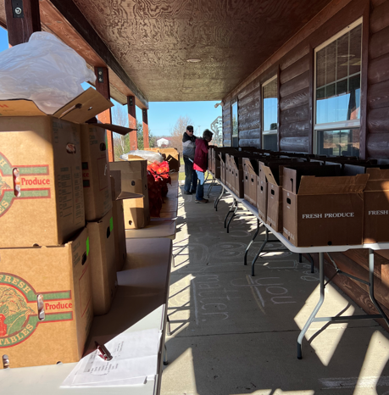
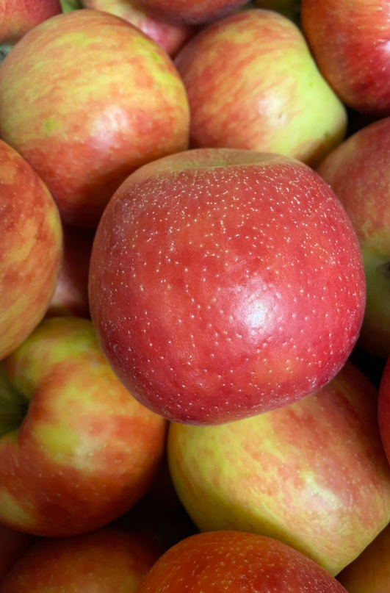
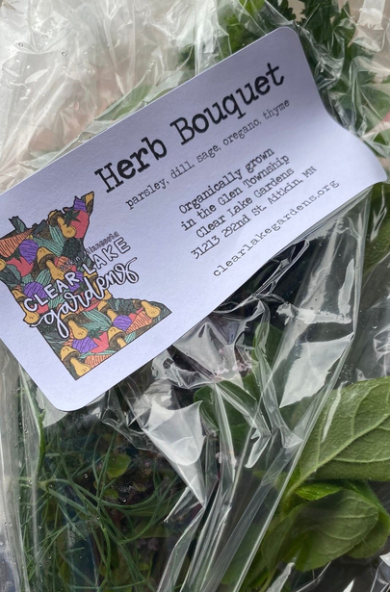
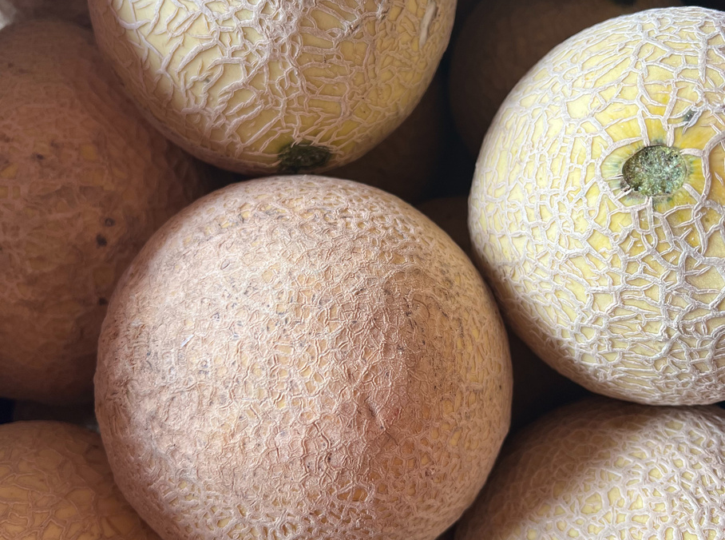
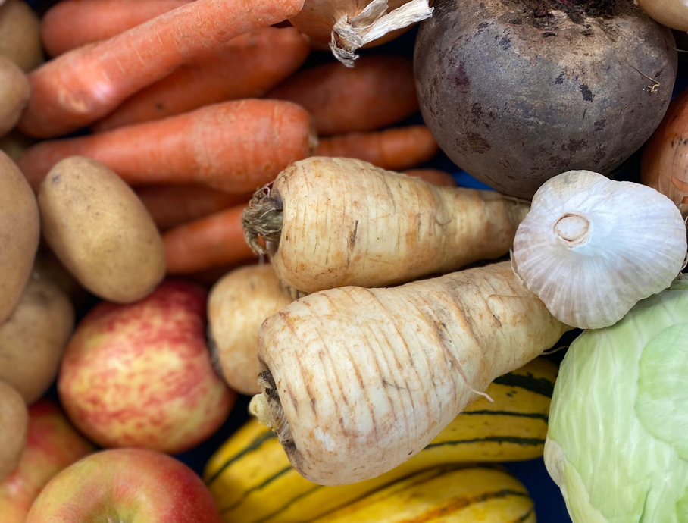
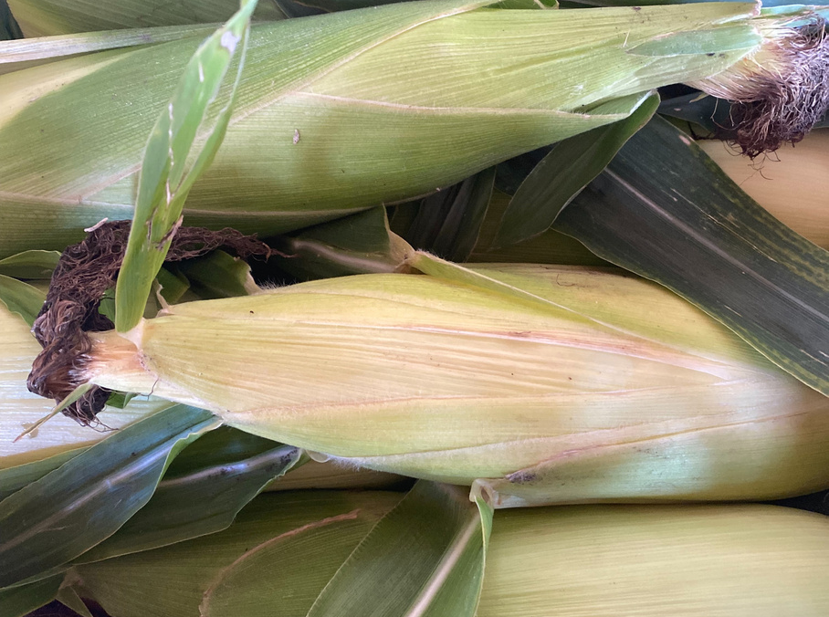
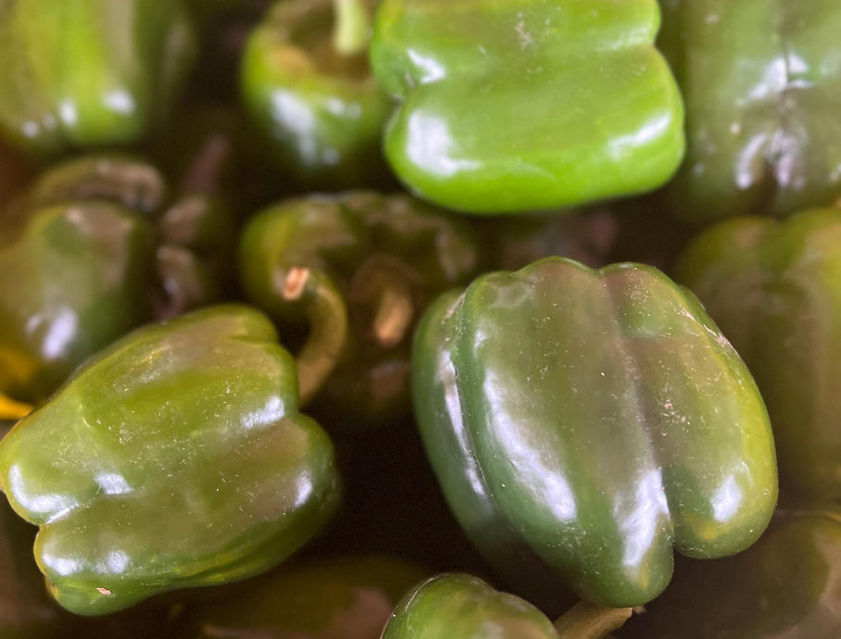

Slide 33
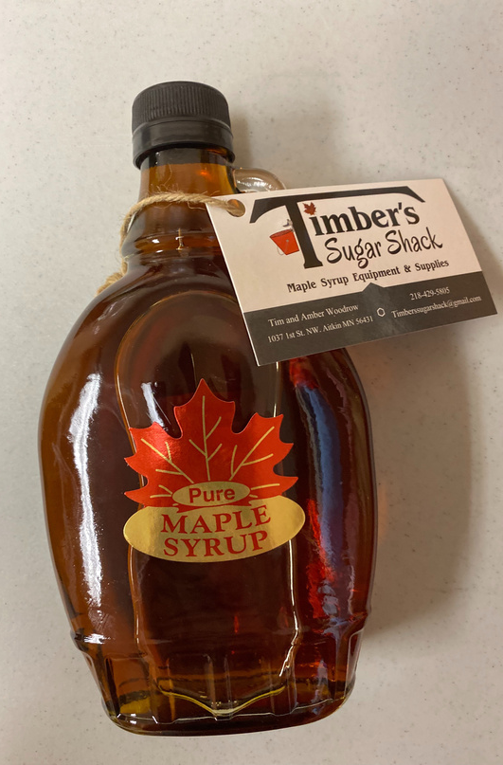
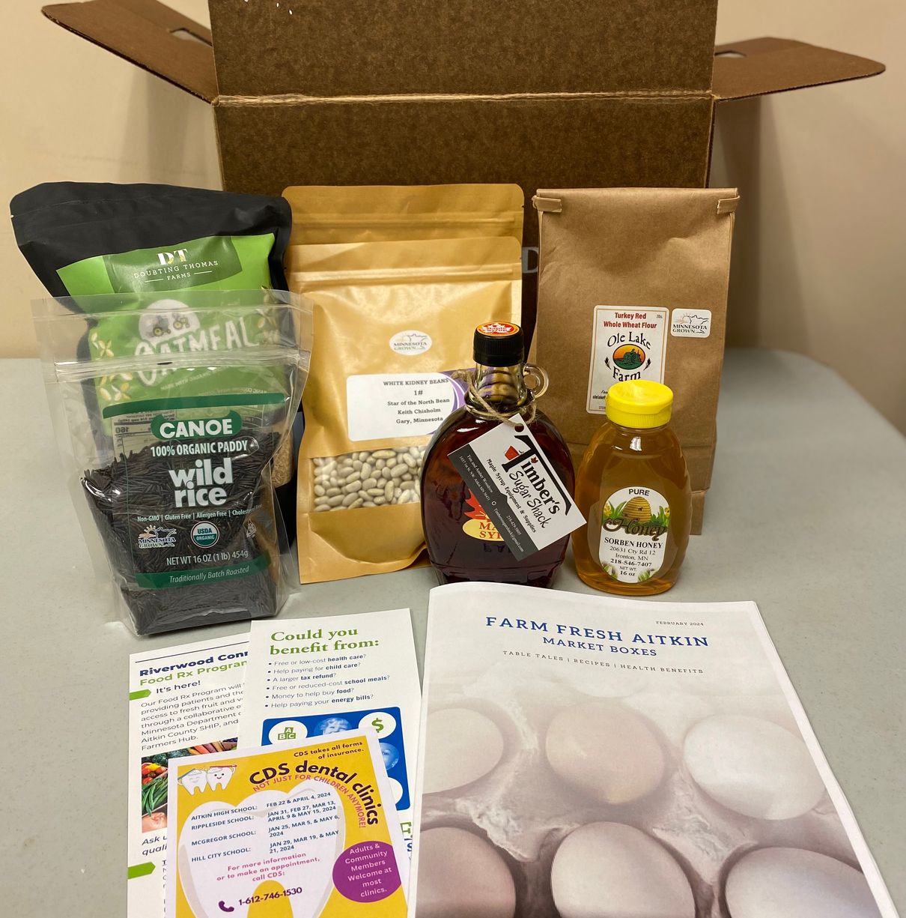
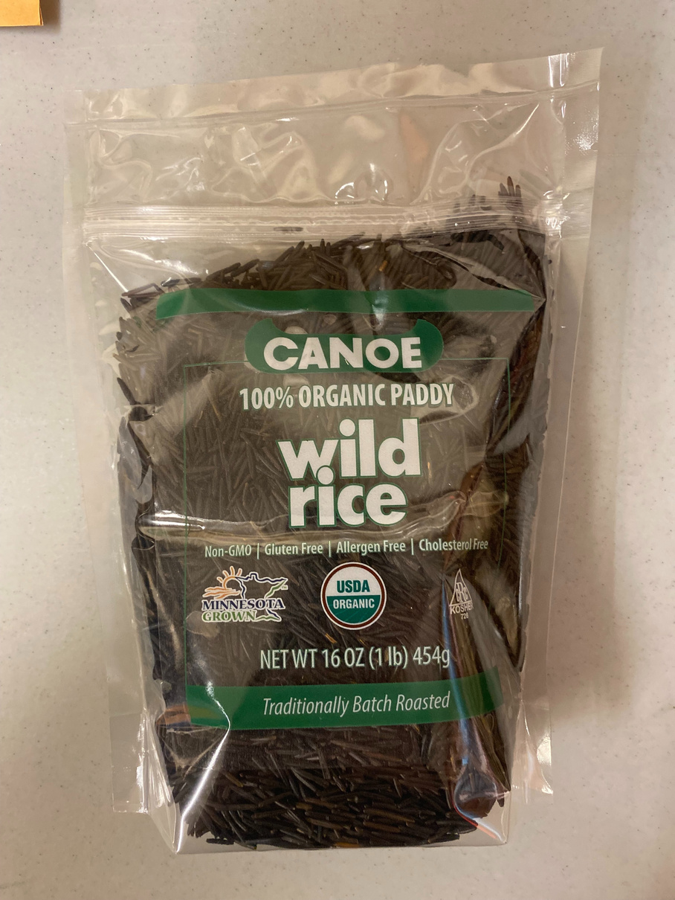
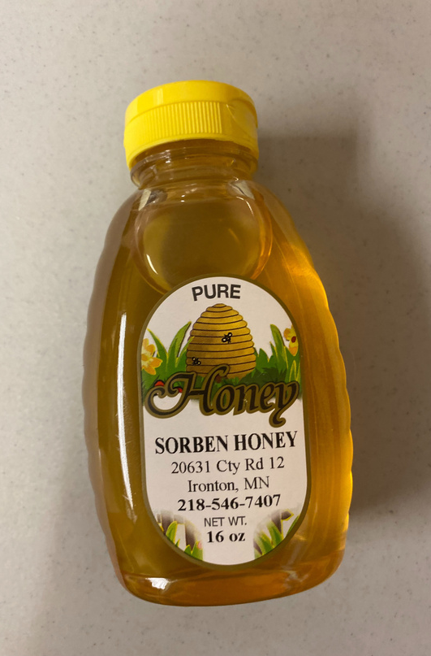
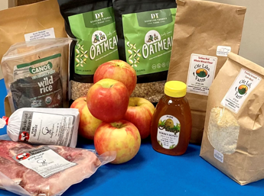
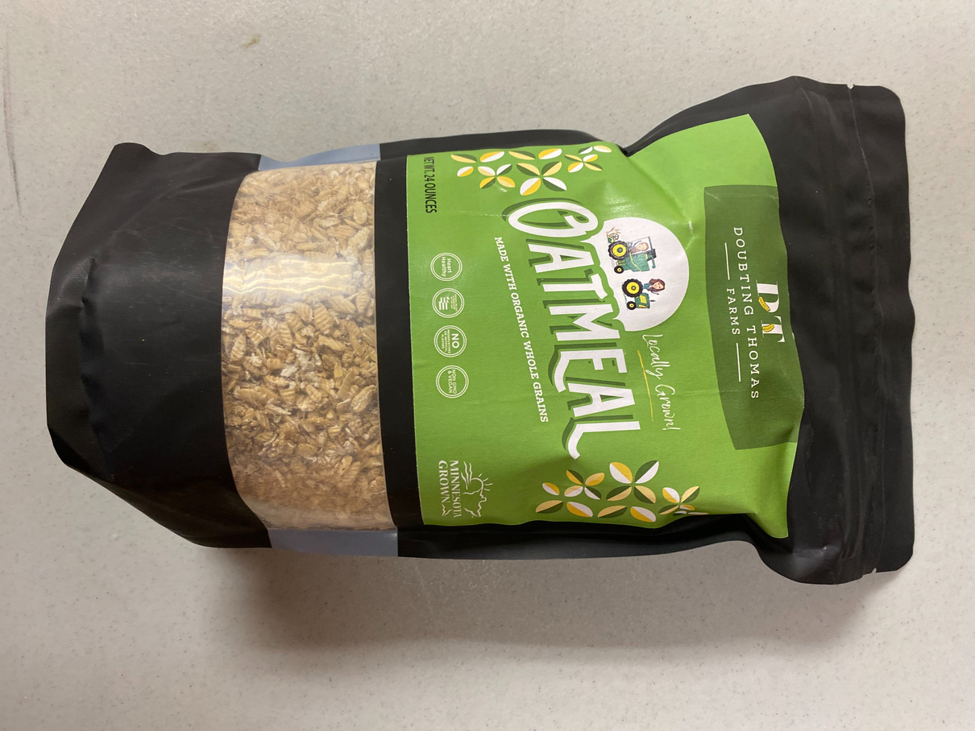
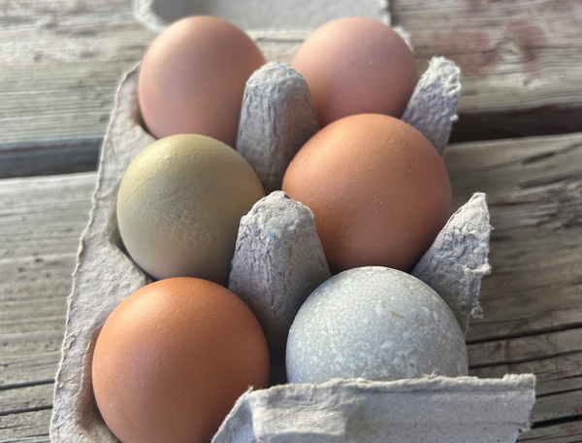
Aitkin Farm Fresh Local Food Promotion Assistance Grant

Slide 34
2023 Year in Review | By the Numbers
Community Partners | Aitkin County Public Health - SHIP Riverwood Healthcare Center Aitkin County Care
Producers | 19 plus Grand Rapids Farmers Market Vendors
Buyers | 8 plus Market Share & Riverwood Boxes (Food Rx)
Market Share Boxes | Total subscriptions sold: 17 Total boxes assembled: 241
Wholesale Sales | Gross sales: $6,050.57 Producer Payments: $5,134.04

Slide 35
2023 Year in Review | By the Numbers
Riverwood Connects Food Rx & Employee CSA | Total boxes assembled: 571
Farm to School Sales | Gross Sales: $29,290.90 Producer Payments: $24,842.05
Totals | Total Gross Sales: $57,415.10 Total Producer Payments: $45,294.20
Scrip Programs | SNAP redeemed: $664.00 Market Bucks redeemed: $440.00 Produce Market Bucks redeemed: $432.00 Kids PoP redeemed: $460.00 Senior PoP redeemed: $402.00 Riverwood Connects Market Bucks: $1,015.00
Education | Cooking Demonstrations: 2 Cooking Educational Reinforcements Provided: 100 Recipes: Over 40 shared Nutrition Facts: Over 25 vegetables

Slide 36
Punching Above Our Weight!
Table 1. Population and income data on participating farmers’ market communities in 2023 | Table 1. Population and income data on participating farmers’ market communities in 2023 | Table 1. Population and income data on participating farmers’ market communities in 2023 | Table 1. Population and income data on participating farmers’ market communities in 2023 | Table 1. Population and income data on participating farmers’ market communities in 2023 | Table 1. Population and income data on participating farmers’ market communities in 2023
Market | City population | County population | Median household income in county | Poverty rate (% of total population) | Poverty rate of children under 5 yrs
Aitkin | 2,168 | 15,697 | 50,900 | 11.6 | 14.6
Grand Rapids | 11,126 | 45,014 | 58,393 | 11.1 | 19.2
Kilimo (Lino Lakes) | 21,399 | 363,887 | 92,133 | 7.6 | 6.5
Mankato | 44,488 | 69,112 | 68,104 | 17.7 | 22.6
Moorhead | 44,505 | 65,318 | 81,386 | 10.9 | 9.4
Red Wing | 16,547 | 47,582 | 71,414 | 8.7 | 14.3
The Village (Rochester) | 121,395 | 162,847 | 86,976 | 9.6 | 5.9
Virginia | 8,421 | 200,231 | 62,704 | 14.7 | 13.7
Wabasha | 2,559 | 21,387 | 70,603 | 7.1 | 9.0
Willmar | 21,015 | 43,732 | 67,798 | 11.0 | 14.4
Source: U.S. Census, census.gov | Source: U.S. Census, census.gov | Source: U.S. Census, census.gov | Source: U.S. Census, census.gov | Source: U.S. Census, census.gov | Source: U.S. Census, census.gov
Notes:
Sales through our hub relative to Aitkin’s income and poverty statistics means we are having a greater impact than the sales number might indicate. Our food dollars mean more to our families and to our farmers.

Slide 37
Market | 2022-2023 grant year sales Oct 1-Sept 30
Aitkin | $32,345.00
Grand Rapids | $41,320.00
Red Wing | $8,719.00
Virginia | $3,313.00
Wabasha | $41,780.00
Willmar | $48,852.00

Slide 38
Sales as a proportion of median household income, adjusted by population and poverty rate

Slide 39
Through the Years Totals
2021 gross sales: $4,849.62
2022 gross sales: $15,687.69
2023 gross sales: $57,415.10

Slide 40
Lessons Learned
Future Ideas
Participant Preference Survey (what things are you willing to try if you had the right education and materials?........)
“Shopping Like Experience” to select vegetables at the pick - up site.
The volume of food being too much. Considering smaller volume for those who feel like they are overwhelmed with the amount of produce.
Capacity of staff and volunteers. Looking at summer Food Rx distribution being every other week instead of every week.
Snack & Fact for participants (featuring local farmers to speak on the local food system in MN).
Cooking classes with University of MN Extension (Jodi Nordlund).
Online educational options
Videos that can be accessed at any time (Find Food Aitkin County website)
Additional visits with Registered Dietitian/s for those who would need more education with produce they are introduced to for the first time.

Slide 41
Partnerships

Slide 42
Thank you!
Do You Have Any Questions?

