Slide 1
Workplace Well-Being
Local SHIP contact name

Slide 2
Workplace Wellness Strategies
For seasoned partners who have worked on these strategies:
  Healthy Foods and Beverages
  Physical Activity
  Tobacco Cessation
  Breastfeeding Support
  Now we’re offering an opportunity to partner with SHIP on:
  Well-being
Notes:
LPH: Use this slide if you are presenting to your Networking Groups or past employers from other collaboratives! Delete the slide if this is a new collaborative.
This presentation focuses on well-being resources.
We’re providing suggestions that will include eleven worksheets/documents that provide steps to implement well-being ideas.
First we’ll look at some data that helps us understand why we’re focusing on well-being.
Then we’ll use a policy, systems and environmental lens.
Finally we’ll explore the eleven ideas.

Slide 3
Agenda
Why well-being at work?
What does well-being look like?
How to implement well-being strategies
Resources

Slide 4
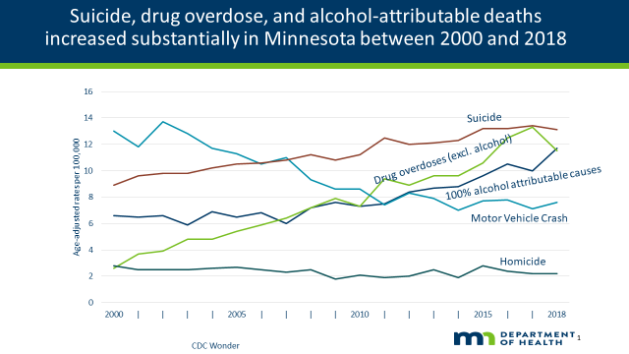
Triple threat.. Now four
MH/Well-being
Notes:
Why are we concerned with well being? The data in this slide and the next indicate that mental health concerns are part of our work lives.
This is a graph of the triple threat to mental health – suicide, drug overdoses, and alcohol-related deaths.
As you can see, Minnesotans die from these three issues suicide, opioid overdoses, and alcohol-related deaths at high rates, which keep getting higher each year. And all have a mental health component, which could play into well-being in a big way.

Slide 5
COVID-19 and increased mental health concerns
In a web-based survey 40.9% of respondents reported:
  Anxiety disorder or depressive disorder symptoms (30.9%)
  Trauma- and stressor-related disorder (26.3%)
  Started/increased substance use to cope (13.3%)
  Seriously considered suicide in the 30 days before survey (10.7%)
CDC: Morbidity and Mortality Weekly, August 14, 2020
Notes:
NOTE TO LPH: These are stats from August 2020 – CONSIDER RECHECKING THEM AS THE PANDEMIC CONTINUES
Symptoms of anxiety disorder and depressive disorder increased in US April–June 2020
During June 24–30, 2020, a total of 5,412 (54.7%) of 9,896 eligible invited adults** completed web-based surveys†† administered by Qualtrics.§§ The Monash University Human Research Ethics Committee of Monash University (Melbourne, Australia) reviewed and approved the study protocol on human subjects
And dealing with COVID-19 has become an increasing concern for mental health. Increases in anxiety, trauma and stress, substances use, and considering suicide all increased over time.
Suicide among respondents ages 18–24 years (25.5%), minority racial/ethnic groups (Hispanic [18.6%], non-Hispanic black [15.1%]), self-reported unpaid caregivers for adults (30.7%), and essential workers (21.7%).

Slide 6
What are you currently doing?
Take inventory of what you are doing around well-being:
Employee Assistance Program (EAP)
Work design
Family-friendly policies
Human Resources orientation and communication
Manager Training
Notes:
Look at your current strategies. Can you get some easy wins from polishing up some of these strategies:
How is the EAP used?
What is the work design like? Do employees know what their job duties entail? Are they cross trained? Is there opportunity for growth if they want it. What is the capacity of the work compared to the skill set of the worker?
Do you offer family friendly policies.
Human Resources
Employee onboarding - communicate values, culture and policies (wellness benefits, healthy eating, active living, tobacco, breastfeeding policies, EAP)
Manager Training
Regularly updated on new policies and procedures
Know how to recognize employees in crisis and who to refer them to (EAP)
Build skills to manage employees for optimal health, productivity and engagement

Slide 7

SHIP focus on PSE
Policy, Systems, Environmental changes
Impacts the culture
Start with easy wins
Notes:
These next slides will give you ideas that you can implement for years to come.
SHIP focuses on policy, systems and environmental changes that can have a positive effect on employee and organizational well-being and provide sustainability for your efforts.
Start with choosing easy wins by looking at current strategies and possibilities.
PSE changes can be more difficult if your organization is working virtually. But there are a wide range of strategies to choose from, and some may make more sense for your organization.
PSE changes are long-lasting ways to build an environment that allows for healthy choices over and over.

Slide 8
Well-being and PSE
Design workspace appropriately for the type of work that has to be done, commit to a decluttered workspace
Optimize employee health support by addressing policies and practices that impact health such as: sick and vacation leave, work remotely, avoid mandatory overtime
Management training (staff development, coaching causes of stress), encourage employee involvement in decision making
Create opportunities to connect people together and avoid social isolation
E
P
S
SS
Notes:
Let’s take a look at the well-being strategy………

Slide 9

11 Well-Being Ideas for Employers
Notes:
Next, we will go over eleven suggestions with accompanying worksheet documents with steps to help you implement.
Learn more about each of these strategies and then decide how you want to move well-being forward.
Review the steps on the worksheet(s) and decide where you can find success.
Start with small steps and a timeline. When you’ve completed one, move onto another. These could potentially be used in perpetuity.
Note for the SHIP coordinator: You can find single page descriptions of these 11 strategy option In BASECAMP/workplace wellness team, in doc & files, strategy materials, workplace well-being.

Slide 10
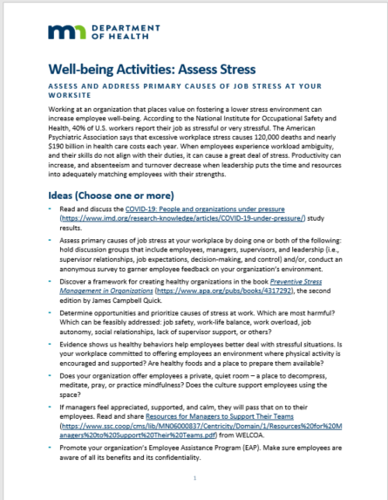
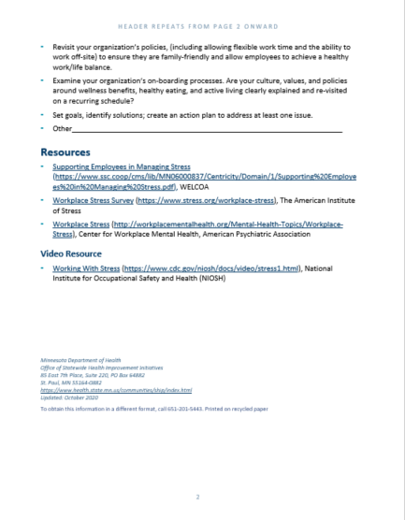
Well-being Strategy Options Offer Details to Implement
Overview
Resources
Ideas for Employer
Videos
Notes:
Each document has an overview of the strategy, ideas for you, the employer, to implement, and then resources and videos to learn more about the strategy.

Slide 11

First steps/assessment
Assess stress
Build resiliency
Connect equity and well-being

Slide 12
1. Assess stress
40% of U.S workers report their job as stressful or very stressful
Working at an organization that values fostering a lower stress environment can increase employee well-being.
Notes:
According to the NIOSH, 40% of U.S. workers report their job as stressful or very stressful.
Working at an organization that places value on fostering a lower stress environment can increase employee well-being.
Productivity can increase, and absenteeism and turnover decrease when leadership puts the time and resources into adequately matching employees with their strengths.
The Assess Stress guide provides ideas for how to reduce stress in the workplaces including assessing the primary causes of job stress and creating a less stressful environment.

Slide 13
2. Build resiliency skills
Socially connected
Joyful
Welcome new experiences
Embrace challenges
Resilient People
Notes:
The workplace is frequently changing, and resilient employees adapt and thrive.
Create opportunities for employees to build and practice resiliency skills -- to be more productive and stay physically and emotionally well.
Resilient people are more joyful, socially connected, welcome new experiences, and embrace challenges.
Ideas to build resilience include reviewing jobs and build in meaning and purpose that connect to your organization’s mission and getting connected with resiliency effort in the community.
And in the short term, for COVID, help your employees stay connected with each other to stay healthy. The challenge of COVID is to help people build resiliency skills while the going is tough. There is more to getting connected in strategy #5 ahead!

Slide 14
3. Connect equity and well-being
Equity is a key ingredient of well-being
  Equity in the workplace means fair treatment for all, supporting coworkers right to be different.
  Equity in the community is defined by all in the community having a fair opportunity to live a long and healthy life.
Notes:
Well-being has many ingredients and the ingredients may differ from person to person.
However, equity is a key ingredient of well-being. Without equity, there can’t be well-being.
Equity in workplaces may be about hiring practices and supports for coworkers’ rights to be improved. It means fair treatment for employees. Another definition of equity is that all people in the community have a fair opportunity to live a long and healthy life.
Employers to have an active role in reducing inequities among their employees and their communities. What is good for the community is good for businesses. Therefore, it is in the best interest of employers to have an active role in reducing inequities among their employees and improving their communities' social conditions.
The strategy document provides several ideas for connecting equity to wellbeing such as learning more about equity, what it means and the importance of inclusiveness at work.

Slide 15

Systems change
Work with an EAP
Get connected
Psychological safety
Reduce mental health stigma
Consider remote workers

Slide 16
4. Work with an Employee Assistance Program (EAP)
Do you offer an EAP?
How can you better utilize your EAP?
If not, is it time to assist employees with skills to help in both their personal and professional world?
Well-being can increase when employees have the tools.
Notes:
Do you currently offer an employee assistance program known as an EAP, to your employees?
If so, how well is it promoted? Are all of the resources offered promoted?
The EAP is often underutilized by most employee groups, but it is a great benefit. They can provide more than counseling.
What does the employers EAP vendor offer? EAPs provide employees with support surrounding both their personal and professional lives. EAP counselors help employees utilize strategies that allow them to better manage stress, which can be due to family issues, workplace conflict and overload, financial worries, and health concerns for self or family.
Purchasing an EAP service is a benefits question, and can help employees with counseling on short term issues, and help them with longer term issues. In this COVID time, many employers are offering more EAP services, increasing the number of sessions available.
Check with your HR manager to see what your organization’s experience as been.

Slide 17

5. Get connected
Fostering social connections at work is important for well-being
Notes:
We are wired to connect, reach out to, and interact with each other. Decades of research suggest that the quality of our social ties might be the single biggest predictor of our well-being
Social connections are good for our health and help us live longer (50% chance of more longevity). Strong social connections lead to lower anxiety and depression, and an increase in self-esteem and greater empathy. Fostering social connections at work is important for well-being in the workplace.
We are wired to connect, reach out to, and interact with each other. Decades of research suggest that the quality of our social ties might be the single biggest predictor of our well-being. A first step in getting connected could be educating the employer and employees on how social connectedness impacts health and surveying your employees to discover how to best support them.

Slide 18

6. Psychological safety
Psychological safety is a shared feeling that it is OK to be open and honest in a group setting
Notes:
Do you have a culture of trust in workplace
Is an environment where employees feel secure enough to be able to share their thoughts and ideas freely without worrying that they are potentially opening themselves up to negative reactions.
Ideas for creating a safe workplace include asking for team’s input and responding positively to questions and doubt.
This is a major culture issue, and may take a longer time to build up in your workplace. It involves the way people are embraced as they share ideas, work together, and adapt to change.
The ways to improve this involve looking at management style, interpersonal norms, and how feedback is given and received.
For now, we’d recommend that you observe the level of psychological safety in your organization and learn about how safe your environment is in order to work on it.

Slide 19
7. Reduce mental health stigma
8 out of 10 workers say shame and stigma prevent them from seeking mental health care
Taking steps to eliminate stigma at work can foster employee loyalty and retention
In one recent poll, 57% of employees said they would be more loyal, more productive, and take less time off work if their employer proactively supported workforce mental health.
Notes:
About 75% of employees have struggled with an issue that affected their mental health. Yet, 8 out of 10 workers with a mental health condition say shame and stigma prevent them from seeking mental health care. That’s a problem for individuals, but it’s also a problem for employers — because untreated mental health conditions cost American companies billions every year. Taking steps to eliminate stigma at work can foster employee loyalty and retention. In one recent poll, 57% of employees said they would be more loyal, more productive, and take less time off work if their employer proactively supported workforce mental health.
Do you hear employees talk about depression and anxiety? Actually, the pandemic has created more awareness of needing to talk about our mental health. It may be an opportunity to help normalize the need to care for our own mental health and check in with others about their mental health.

Slide 20
8. Consider remote workers
Fostering a workplace culture that prioritizes an appropriate work/life integration can improve employee well-being.
Work
Life
Notes:
Working from home can be detrimental to individual physical and emotional well-being due to limited options for physical activity and social interactions. Physical and emotional well-being can improve by staying active, participating in activities that reduce stress reactions and keeping engaged with colleagues.
Work and home life can become blurred when working from home. This lack of separation between work and home life can lead to burnout and cause mental health to suffer.
Fostering a workplace culture that prioritizes an appropriate work/life balance can do much to improve employee well-being.
This step involves looking at ways to assist your employees who work remotely to be able to make healthy choices while working from home.

Slide 21


Policy and environmental changes
Create life-friendly policies
Create quiet spaces
Safe work spaces

Slide 22

9. Create life-friendly policies
Employers offering more options regarding when, where, and how work is done
Companies with family-friendly policies experience short and long-term benefits.
Notes:
Employers are increasingly embracing workplace flexibility by offering more options for their employees regarding when, where, and how work is done.
Companies with family-friendly policies experience various short and long-term benefits. Studies show that companies that switched specific policies, such as flexible schedules or job-sharing policies saw higher workplace productivity and a higher retention of quality employees.
It might be a good time to take inventory of your employee policies and see if there are ways to provide more family and life-friendly opportunities. It’s good for morale and employee retention. Younger employees often look for more perks in flexibility.

Slide 23

10. Create quiet spaces
Quiet spaces in the workplace used for reflection, prayer, and relaxation
It provides a peaceful space in which employees can escape the work demands
Notes:
We have a strategy option document dedicated to creating quiet spaces. Quiet spaces in the workplace can be designated for reflection, prayer, and relaxation for all employees.
It provides a peaceful space in which employees can escape the work environment's demands while not disrupting general operations.
It’s important to offer a “stress safety valve” during the workday. It may be an actual room or a protected break time.
How can your employees find quiet at work? In their day? Working remotely?

Slide 24
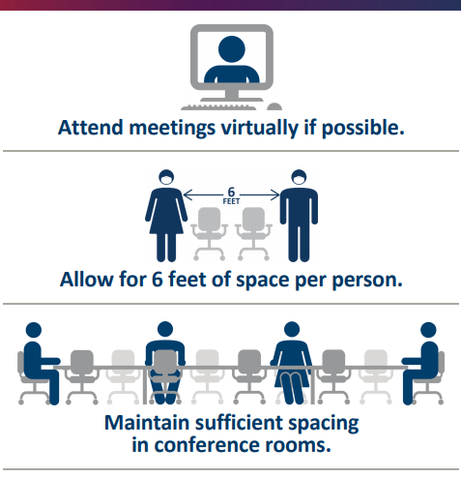
11. Safe workspaces
Creating a safe work environment will reduce the transmission of COVID 19
Addressing concerns with sound practices will ensure confidence while managing employees' and visitors' physical and emotional health.
Notes:
Creating a safe work environment is a critical responsibility that will reduce the transmission of COVID 19.
Addressing specific concerns with sound practices will go a long way to ensuring public confidence while managing employees' and visitors' physical and emotional health.
Work with your safety and wellness committee to form a plan that meets all employees' and visitors' needs.

Slide 25
Questions for your next steps
Which of the 11 strategies speak to you?
What do you think your employees need most in during the pandemic?
Who should you connect with to decide a course of action?
  Leadership?
  Your committee?
  HR?
Would it be better to strengthen some current well-being practices?
Notes:
There are so many options to choose from, and it may be difficult to determine where to start.
Consider these questions as you move ahead (You can lead a small group discussion about these with your group during the meeting)

Slide 26
Questions?
Thank you for coming!
< insert your contact info>

